Slide 1


TATA Data Visualization

Slide 2
Introduction
Hello. In this presentation, we will go through the company’s sales performance for the years 2010 and 2011.
I appreciate the opportunity given to me to dive into this data to gain and discuss the insightful information about the Tata’s performance.

Slide 3
Process
The necessary steps taken include:
Data Cleaning by removing the negative values for price and zero values for quantity
Data Filtering for the required tasks

Slide 4
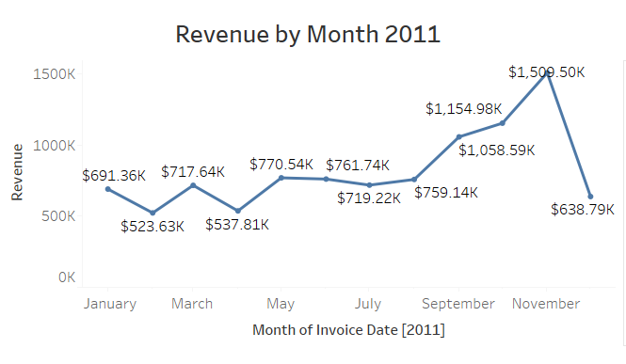
Revenue by Month for 2011
The first 8 months had stable monthly revenues with minor fluctuations. The average revenue was $685,000.
We had a significant increase in revenue from September with the revenue peaking at $1.15 Million in November and an average of 21.18% increase in revenue from August to November.

Slide 5
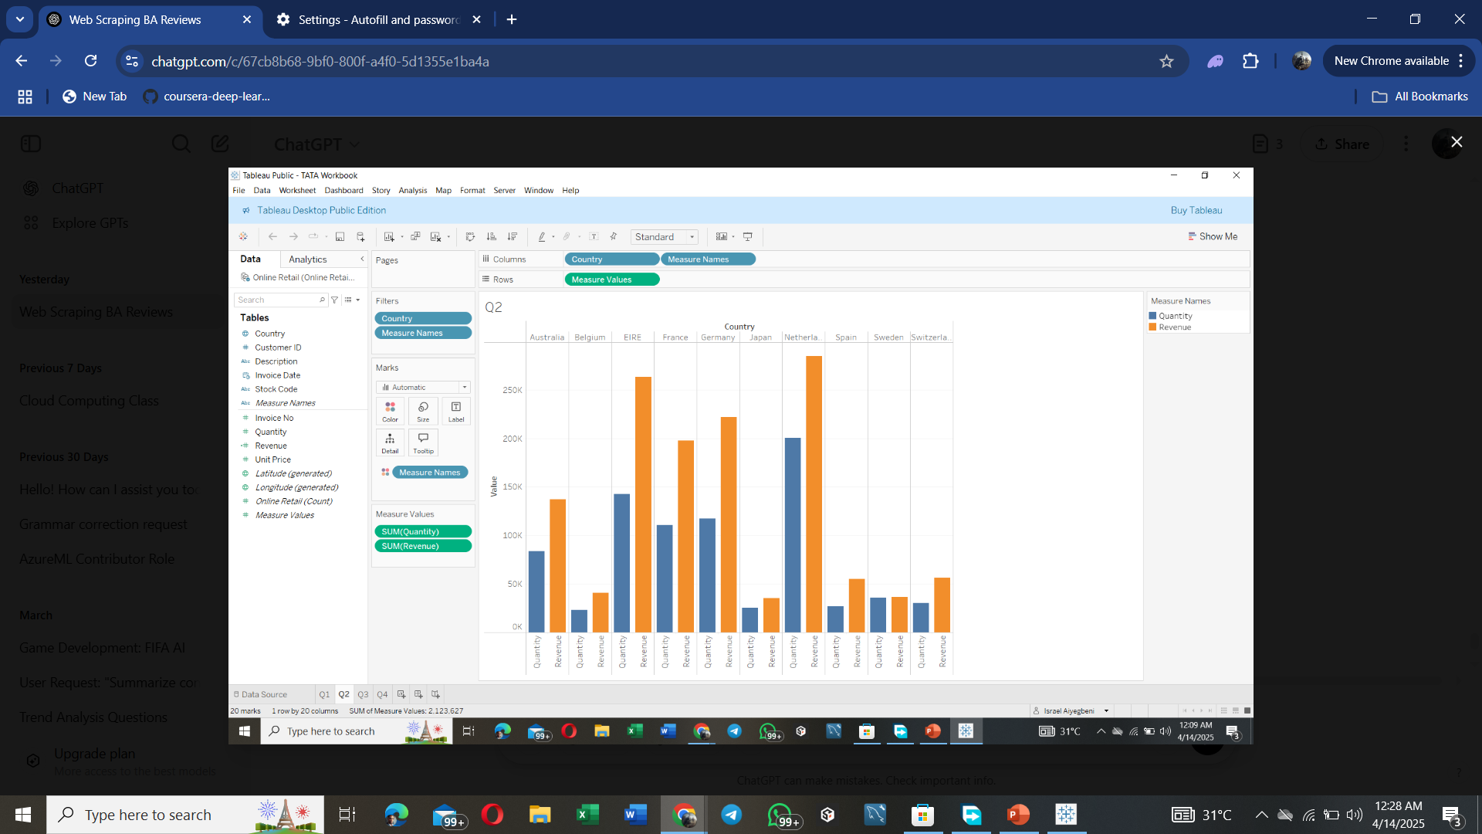
Top 10 Countries by Revenue and their Quantity
This chart represents the top 10 countries in the revenue and the quantities bought in these countries except The United Kingdom which is the largest market and not needed for this analysis.
There is no major difference between the revenue and the quantity of goods sold in these countries, showing a high purchasing power in these countries. Although High revenue ≠ high quantity: For example, Spain shows high revenue but not necessarily the higher quantity when compared to Sweden and switzerland. This implies higher unit prices or premium product sales.
These countries represent regions with the highest potential to generate more revenue that management needs to focus more on in terms of marketing strategies
Some countries (like Switzerland or Sweden) show lower performance in both revenue and quantity, suggesting possible under-penetration or market potential.

Slide 6
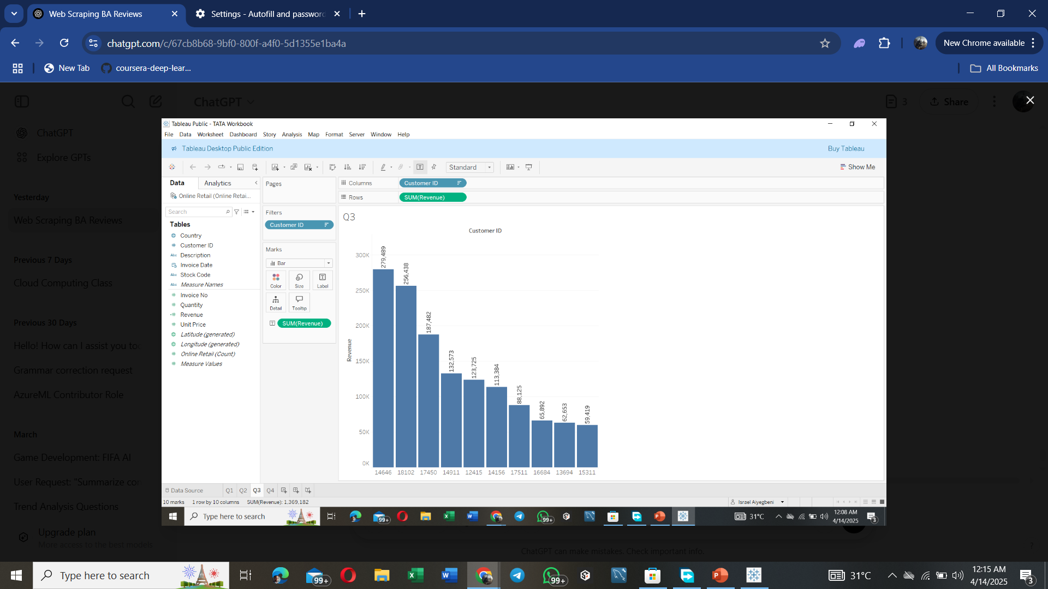
Top 10 Customers by Revenue
This chart highlights the top 10 revenue-generating customers
Customers are sorted in descending order of revenue (left to right), which aligns with the CMO’s goal of identifying and retaining top buyers.nce between the top 10 customers in terms of revenue generated.
The average difference is revenue between the top 10 customers in 15.8%.
Strategic opportunity: These top customers should be targeted for retention and maybe offered incentives or loyalty programs.

Slide 7
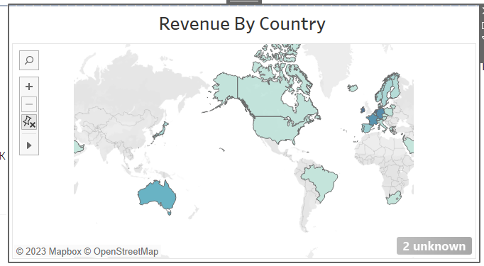
Revenue by Countries
The map chart concludes by comparing the places that have produced the greatest revenue to those that have not.
The map also reveals that the majority of sales occur only in the European zone , with a small number in American region.
Along with Russia, there is no market for the items in Africa or Asia.
The company can concentrate on the European market more and dive deeper into countries in the region to come up with strategies that will maximize sales from each country in the region alongside Australia and Japan

Slide 8
Recommendations
Market Expansion opportunity - Target the least performing countries in the top 10. Investigate market barriers—such as shipping costs, product fit, or local competitors. Consider targeted promotional campaigns or partnerships in these regions to increase brand awareness.
A deeper dive into the type of products and the revenue generated from these products for each region would be key in guiding region specific marketing strategies.
Launch a VIP loyalty program for top customers (e.g., exclusive discounts, early access to new products)..
The European market has more potential for growth and the company should aim at strategies that will increase its market positioning in the region.

